Slide 1
Browser Extensions Wilmette Library
Boost your comfort and productivity on the internet with browser extensions.
This class will shop for recommended extensions, install them, and learn to use them on Firefox, Chrome, and Safari.

Slide 2
Web browsers are not search engines.
A web browser, also known as an internet browser or simply a browser, is a software application that lets people access the World Wide Web.
Browsers are used on desktops, laptops, tablets, and smartphones.
Google Chrome is by far the most popular browser. Source
— Source: https://www.avast.com/c-what-is-a-web-browser
Notes:
https://gs.statcounter.com/browser-market-share

Slide 3
BROWSERS OVER 1996-2019
https://www.visualcapitalist.com/internet-browser-market-share/
Source:

Slide 4
“An extension adds features and functions to a browser”
Created by people, organizations, and companies.
They
have their own online shops
which are browser-specific.
More Info! https://developer.mozilla.org/en-US/docs/Mozilla/Add-ons/WebExtensions/What_are_WebExtensions
They are almost always free.
Notes:
Browser-specific : some extensions are available only for certain browsers. This is about whether the developer has the bandwidth to make their extension available on multiple browsers - it’s work to adapt your extension to each of them.

Slide 5
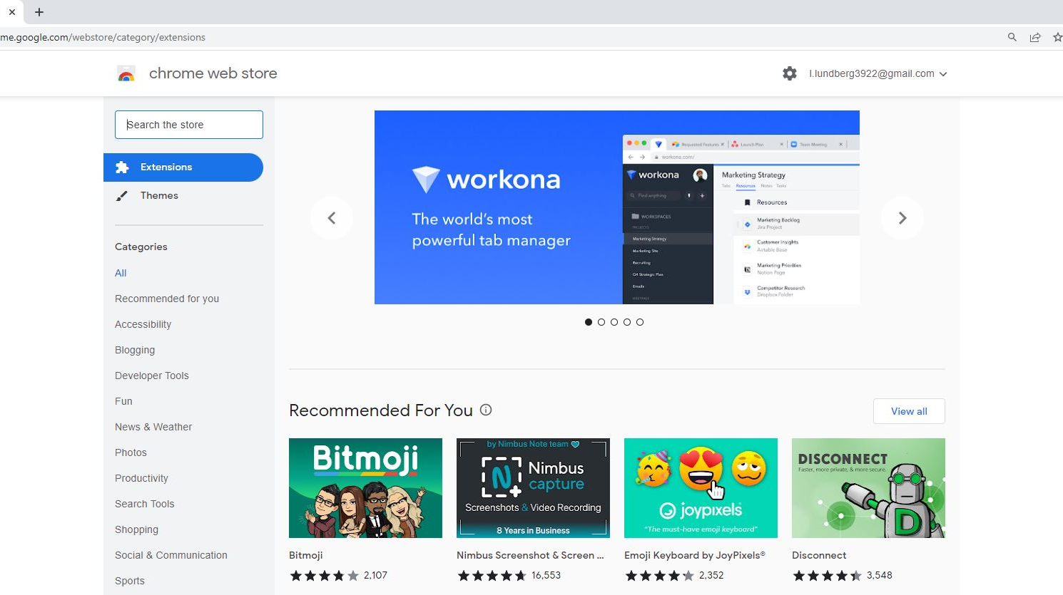
CHROME BROWSER
chrome web store
https://chrome.google.com/webstore/category/extensions

Slide 6
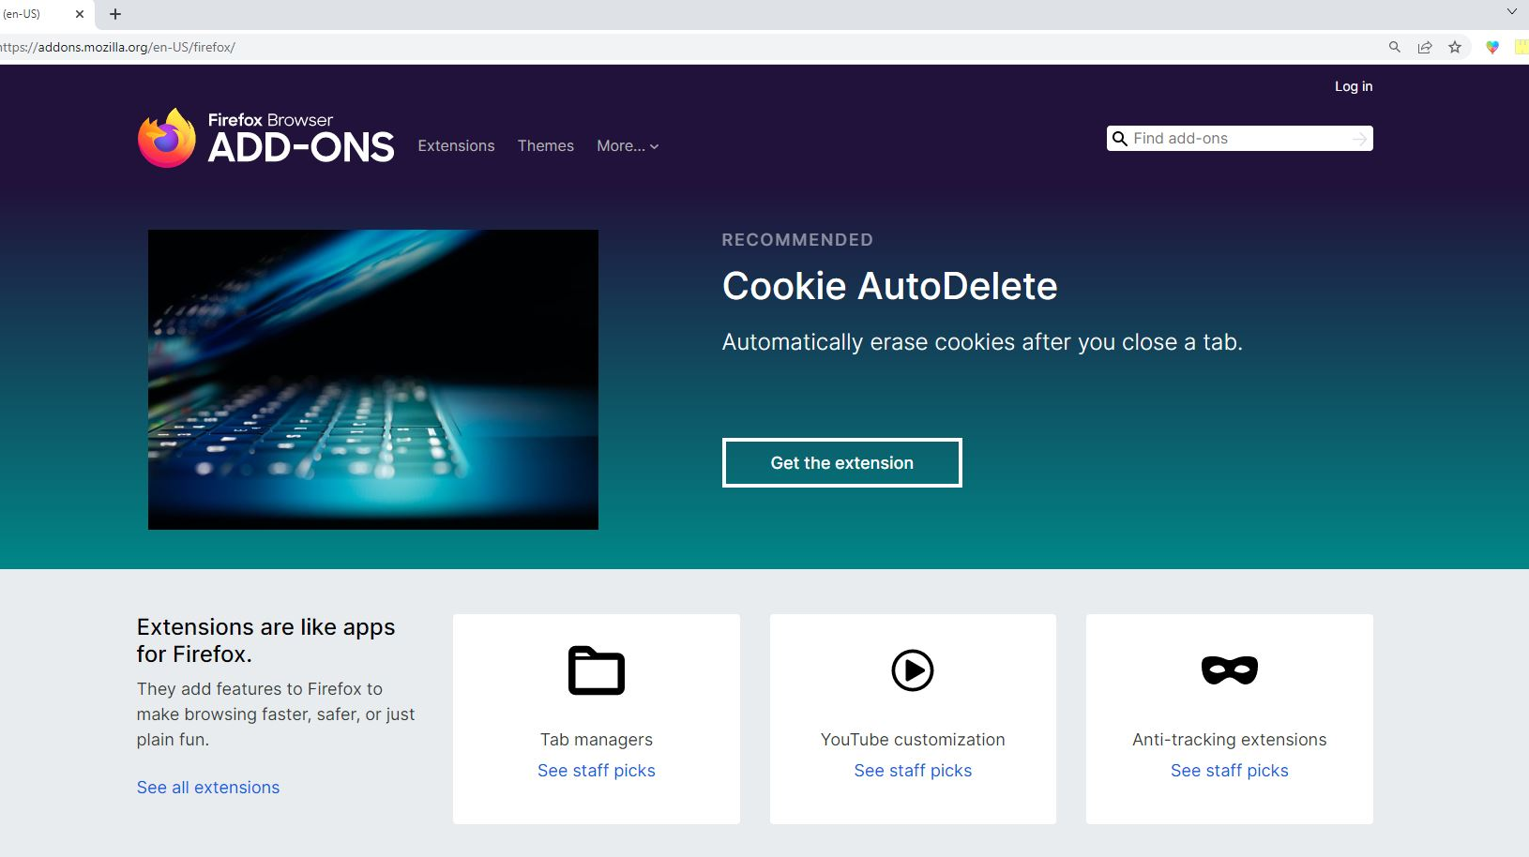
FIREFOX BROWSER
Firefox Browser Add-Ons
https://addons.mozilla.org/en-US/firefox/

Slide 7
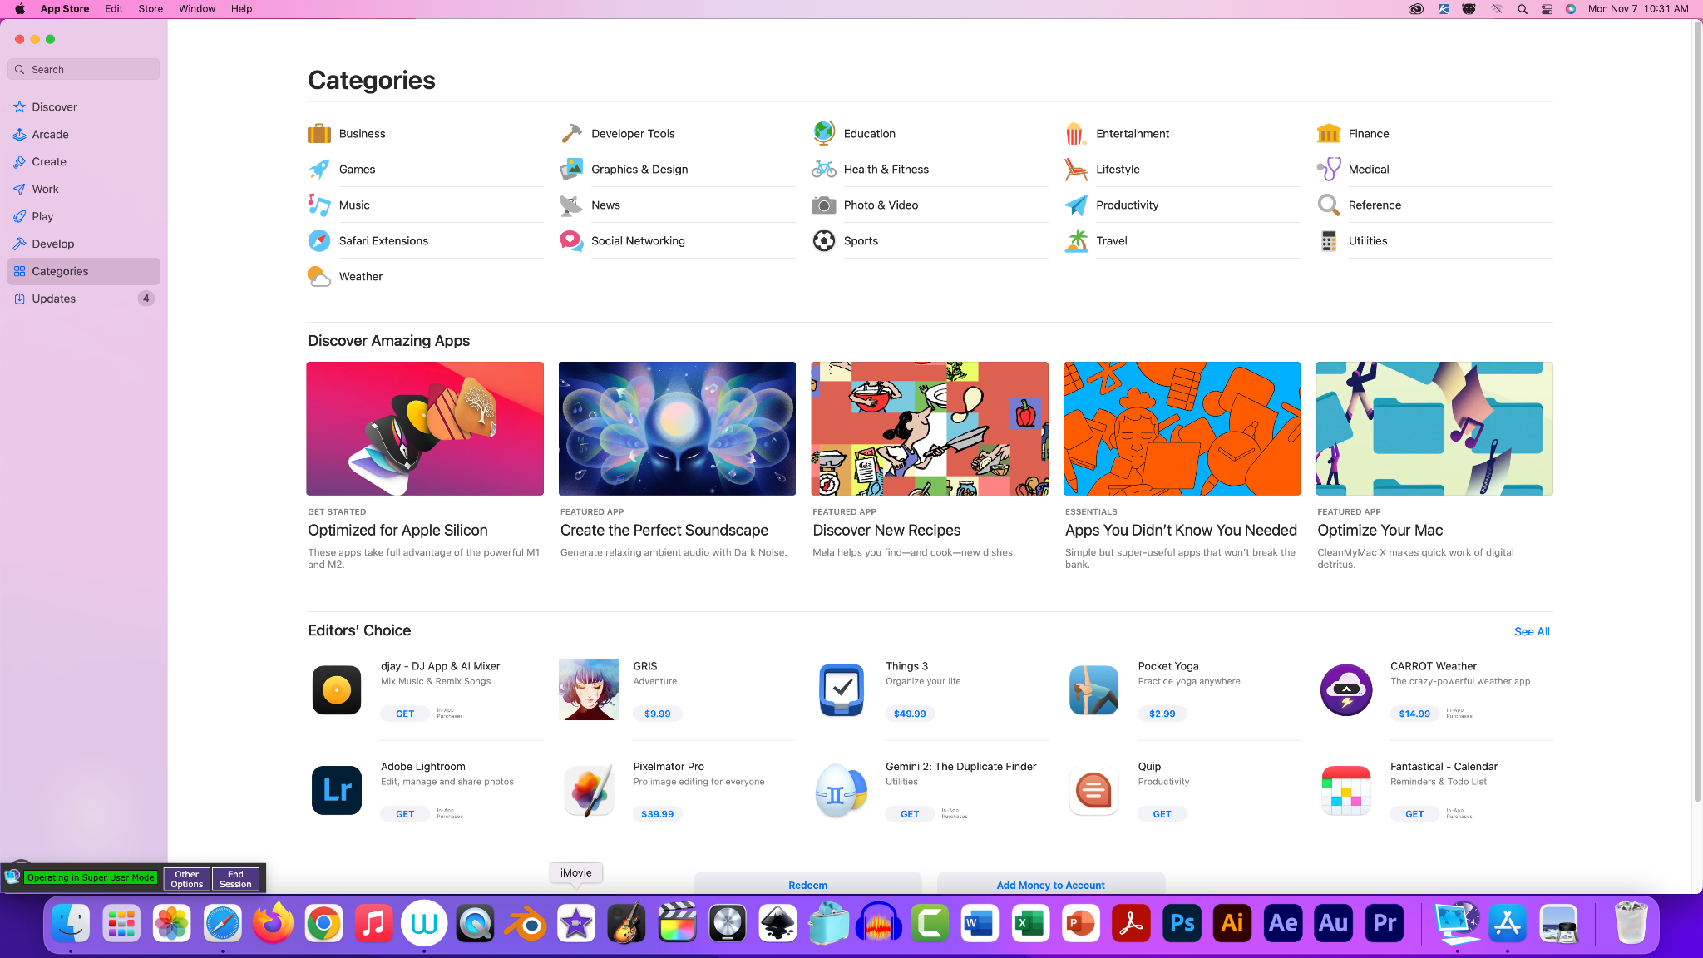
SAFARI BROWSER
Safari’s Extensions are found in Apple’s App Store
https://apps.apple.com/us/story/id1377753262
(^ if you click on the above link on an Apple device, you should be taken to the Apple App Store program)

Slide 8
HOW TO KNOW IT’S OKAY
Before you download a browser extension, investigate them.
Extensions were made by someone
Extensions get rated
Extensions get reviewed
HOW MANY REVIEWERS?
WHO MADE THIS?
RATINGS
4/5 or 5/5 stars? Nice.
Take a second to look up the developer.
Thousands? Nice.
Notes:
So interesting to find the developer, especially if they’re independent. They’ll turn you onto places you never would’ve gone on the internet. It’s a fun rabbithole. You can also find other great useful tools by following developers of programs, services, extensions, userscripts that you like.

Slide 9
EXTENSIONS HAVE WEBSITES
INDIE DEVS
ORGANIZATIONS
Independent developers are programmers/coders that create useful online tools for themselves and then choose to share it for free with others. Sometimes they create their own small company
Tech nonprofits like the Electronic Frontier Foundation and the Internet Archive have created and shared extensions
Notes:
Indie devs often have a ‘donate’ option so you can monetarily show your appreciation of their work.

Slide 10
EXTENSIONS & COMPANIES
COMPANIES
Mozilla and Chrome themselves offer ‘official’ extensions to their browsers.
Also tons of other companies helping you to access their stuff or use their services. Best Safari Extensions in 2022
COMPANIES OFFER SERVICE INTEGRATIONS
Lastpass, Pocket, Paypal, Grammarly, Pinterest, etc.
Notes:
Instapaper

Slide 11
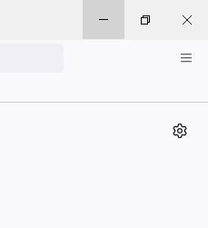
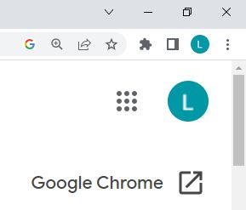
INSTALLED! NOW WHAT?
^ Firefox
^ Google Chrome

Slide 12
RECOMMENDED EXTENSIONS
Here are some books- and news-oriented extensions.
Library Extension
As you browse books and e-books, the Library Extension can check your library's online catalog and display the availability of that item on the same page.
Github and gitlab are repositories for coders.
https://www.libraryextension.com/
Bypass Paywalls
Remember commerce is good
This add-on allows you to read articles from websites that implement a paywall. Firefox only but similar extensions exist for all browsers.
https://gitlab.com/magnolia1234/bypass-paywalls-firefox-clean

Slide 13
RECOMMENDED EXTENSIONS
Here are some privacy-related extensions.
uBlock Origin
Free, open-source ad content blocker.
Ad-blockers are a standard.
https://ublockorigin.com/
HTTPS Everywhere
HTTPS too
HTTPS Everywhere encrypts your communications with many major websites, making your browsing more secure.
https://www.eff.org/https-everywhere

Slide 14
RECOMMENDED EXTENSIONS
Here are some productivity-related extensions.
Sticky Notes
So many interesting web extensions that allow you to create sticky notes on your desktop or webpages. Link below is for Chrome.
To Do list extensions
https://www.webpagestickynotes.com
TabSnooze
Time tracking extensions
Save articles, videos and todos for later. They'll magically reopen when you need them. Chrome only.
https://chrome.google.com/webstore/detail/tab-snooze/pdiebiamhaleloakpcgmpnenggpjbcbm

Slide 15
LINNÉA’S FAVES
InstaPaper as an online service with integrated extension
Firefox Multi-Account Containers by Mozilla Firefox Devs
Emoji Keyboard for Chrome & Firefox
Reddit Enhancement Suite
OneTab for Firefox and Chrome
Enhancer for YouTube

Slide 16
THANK YOU!
DO YOU HAVE ANY QUESTIONS?
llundberg@wilmettelibrary.info
+1 847 256 6914
https://www.wilmettelibrary.info/technology-classes

